Slide 1
Data Mining: Introduction
Tom Heskes

Slide 2




Instructors
Tom Heskes Tom Claassen tomh@cs.ru.nl tomc@cs.ru.nl
lectures/general stuff lectures
Roel Bouman roel.bouman@ru.nl
practical sessions
Olivier Claessen olivier.claessen@ru.nl
practical sessions
student assistants (practical sessions, grading):
Nienke, Janneke, Fenna, Tim, Nadezhda, Alex, Steffen, Luco, Bram, Robin, Anessa, Tygo, Saskia, Amit, Elina

Slide 3
Course Outline
6 ects = 8 hours per week
Lectures on Wednesday
Practical sessions on Fridays/Tuesdays either physically or on-line (Discord)
Midterm and endterm exam on campus
“Learning tasks”: optional reading material + exercises for self study
Lots of info on Brightspace

Slide 4
Evaluation
Two multiple-choice exams: one mid-term and one end-term*
Project (more details later)
Six homework assignments
Mandatory: score ≥ 5.5 for at least 4 out of 6 homework assignments!
Final grade: 0.35 × Midterm + 0.35 × Endterm + 0.3 × Project**
If all else fails: risk of full repeat next year
*Average of the exams needs to be at least 5.0 to pass the course.
**If final grade ≥ 5.5 (pass), average of homework assignments replaces half of the average exam grade or the project grade if it helps to give you a higher grade.

Slide 5
Lectures
No streaming or recording
Video lectures from earlier years available in Brightspace

Slide 6
Homework assignments
Apply and understand data mining algorithms on (small) data sets
Python:
open source, growing fast
many great data mining / machine learning packages
Assistants at practical sessions are there to help you!
Work in pairs (highly preferabe) or on your own (only if you “have to”); strictly follow guidelines on Brightspace!

Slide 7
Practical sessions
Starting this week on Friday and next week Tuesday
The place to ask for help, with homework or other exercises
Feel free to pick the slot that suits you best
First sessions: get used to Python
In preparation: download and install the 3.8 version at https://www.anaconda.com/download/

Slide 8
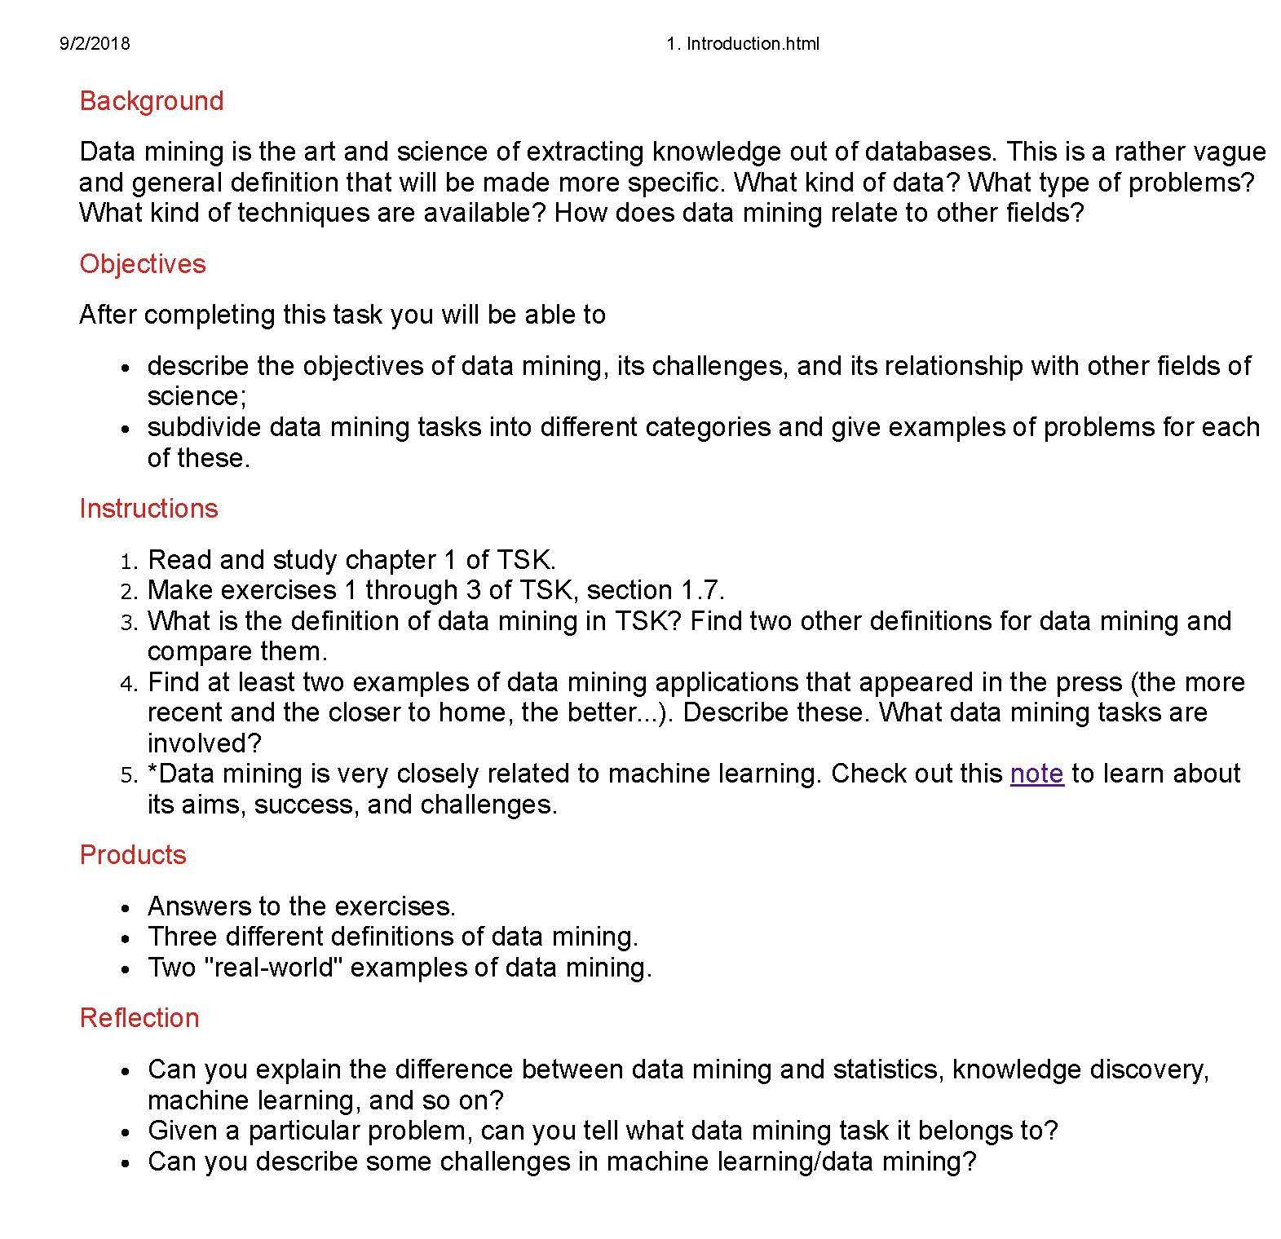
Learning tasks
Course Content → Learning Tasks
To keep track and to study for exam
Exercises are meant to practice
Ask feedback when stuck on one of the exercises!

Slide 9
Contents
We will somewhat follow the first edition of the book “Introduction to Data Mining” by Tan, Steinbach and Kumar
See https://www-users.cs.umn.edu/~kumar001/dmbook/firsted.php/ where you can find slides, errata and some chapters
Chapters 1, 2, 3, 4, 8, 10, 6, 5

Slide 10
Advice
Keep track
Follow the lectures
Start looking at the homework at least 2 weeks before the deadline
Practice with some of the exercises mentioned in the learning tasks
If you’re stuck, formulate why and ask!

Slide 11
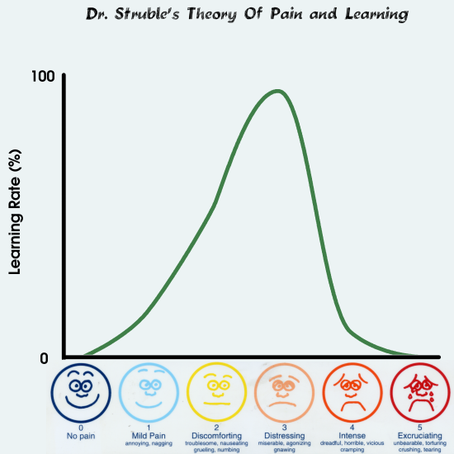
Theory of Pain and Learning
Struble, 2004

Slide 12
Data Mining: Introduction
Motivation
Examples
Bit of history
Challenges

Slide 13






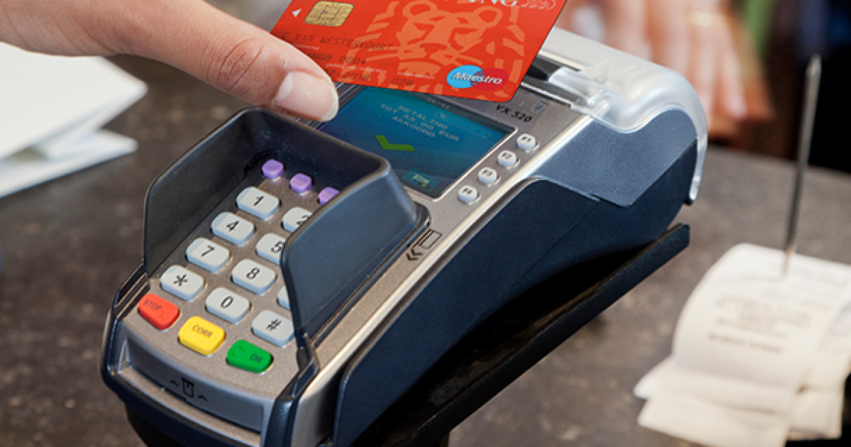

Why Mine Data? Commercial Viewpoint
Lots of data is being collected and warehoused
web data, e-commerce
purchases at department/ grocery stores
bank/credit card transactions
Computers have become cheaper and more powerful
Competitive pressure is strong
provide better, customized services for an edge (e.g. in customer relationship management)

Slide 14
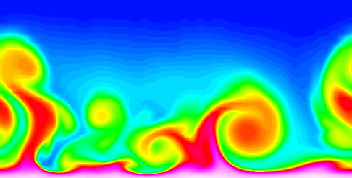
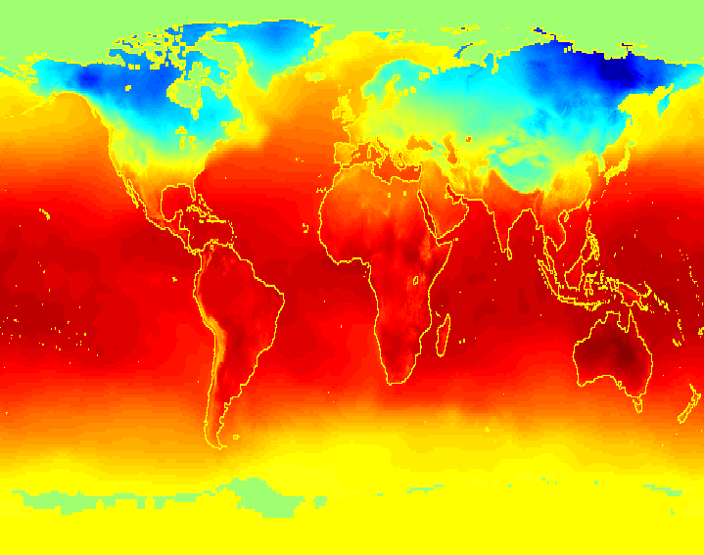
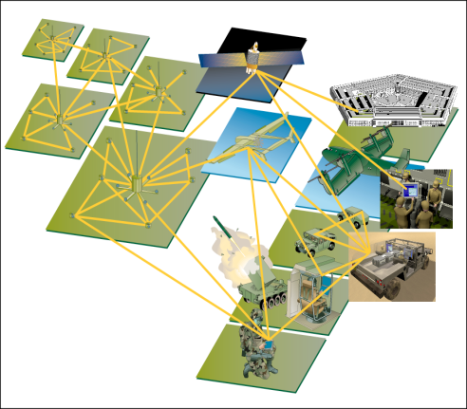
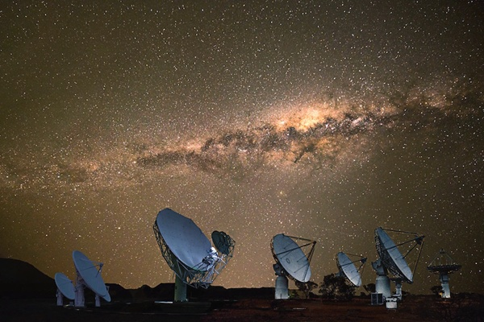
Why Mine Data? Scientific Viewpoint
Data collected and stored at enormous speeds (Gb/hour)
remote sensors on a satellite
telescopes scanning the skies
microarrays generating gene expression data
scientific simulations generating terabytes of data
Traditional techniques infeasible for raw data
Data mining may help scientists in classifying and segmenting data in hypothesis formation

Slide 15
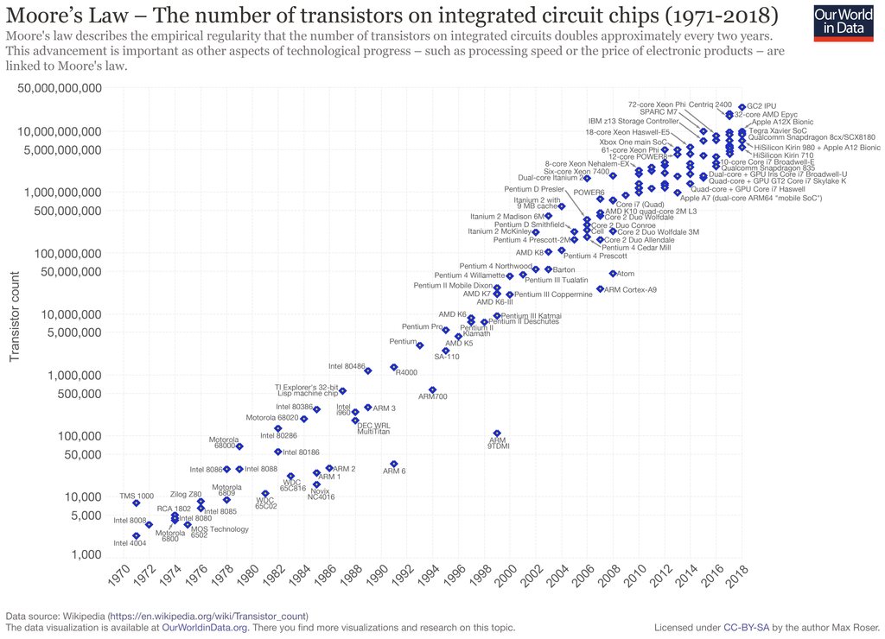
Moore’s law

Slide 16
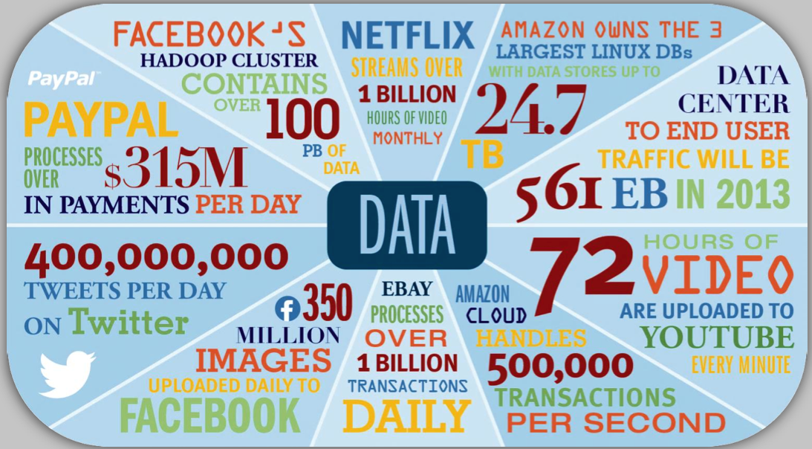
Mining Large Data Sets - Motivation
Current data volume estimated at ~50 Zettabyte (10¹³ GB), and doubling every 1.5 years
There is often information “hidden” in the data that is not readily evident
Human analysts may take weeks to discover useful information
Much of the data is never analyzed at all
Total new disk (TB)
Number of analysts

Slide 17
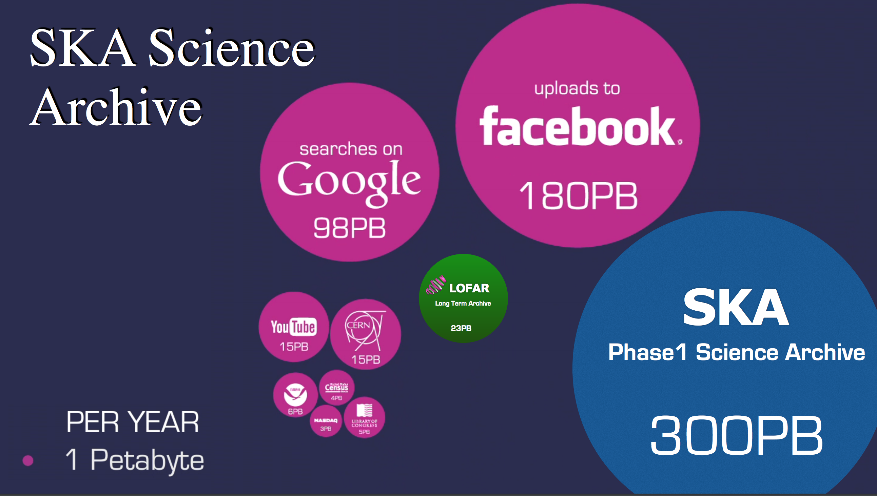
Examples of Massive Datasets
Pubmed text database
Records for >30 million published articles
Web search engines
60 billion Web pages indexed
100’s of millions of site visitors per day
CALTRANS loop sensor data (traffic)
Every 30 seconds, thousands of sensors, 2 Gbytes per day
NASA MODIS satellite
Coverage at 250m resolution, 37 bands, whole earth, every day
Retail transaction data
Ebay, Amazon, Walmart: >100 million transactions per day
Visa, Mastercard: similar or larger numbers

Slide 18
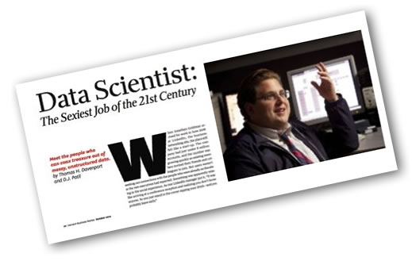
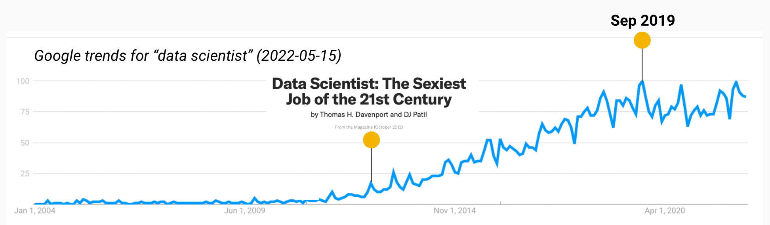
Harvard Business Review

Slide 19
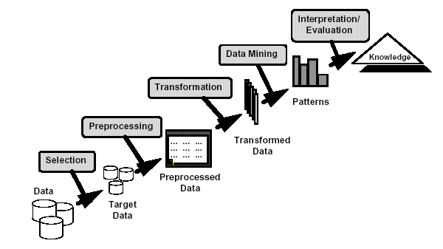
What is Data Mining?
Many definitions:
Non-trivial extraction of implicit, previously unknown and potentially useful information from data
Exploration & analysis, by automatic or semi-automatic means, of large quantities of data in order to discover meaningful patterns

Slide 20
Another Definition
“Data-driven discovery of models and patterns from massive
observational data sets”
Languages and
Representations
Engineering,
data management
Statistics,
inference
Retrospective analysis
Smyth, 2003

Slide 21
What is (not) Data Mining?
What is not Data Mining?
Look up phone number in phone directory
Query a Web search engine for information about “Amazon”
What is Data Mining?
Certain names are more prevalent in certain US locations (O’Brien, O’Rurke, O’Reilly… in Boston area)
Group together similar documents returned by search engine according to their context (e.g. Amazon rainforest vs. Amazon.com)

Slide 22
Origins of Data Mining
Draws ideas from machine learning/AI, pattern recognition, statistics, and database systems
Traditional techniques may be unsuitable due to
Enormity of data
High dimensionality of data
Heterogeneous, distributed nature of data
Statistics/ AI
Machine Learning /
Pattern Recognition
Data Mining
Database systems

Slide 23
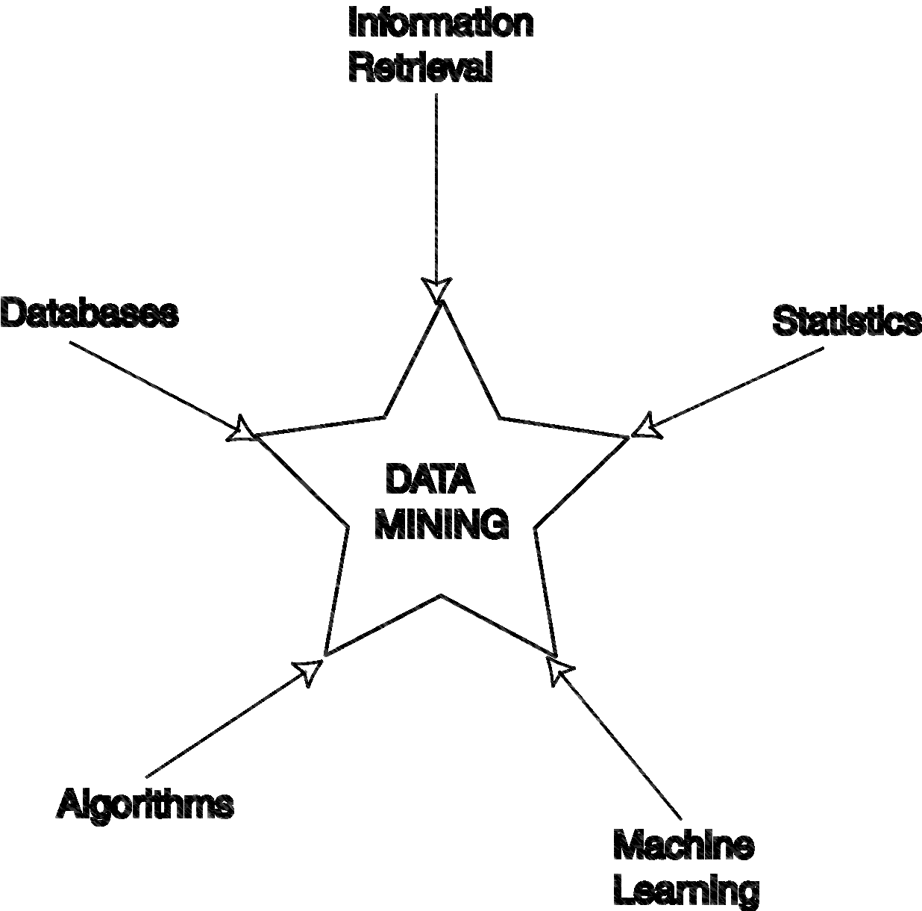
Data Mining Development
Similarity measures
Hierarchical clustering
IR systems
Imprecise queries
Textual data
Web search engines
Relational data model
SQL
Association rule algorithms
Data warehousing
Scalability techniques
Bayes theorem
Regression analysis
EM algorithm
K-means clustering
Time series analysis
Algorithm Design Techniques
Algorithm Analysis
Data Structures
Neural networks
Decision tree algorithms
Dunham, 2003

Slide 24
Origins of Data Mining
pre 1960 1960’s 1970’s 1980’s 1990’s
Hardware
(sensors, storage, computation)
Relational
Databases
Pattern
Recognition
Data
Mining
Artificial Intelligence
Machine
Learning
“Flexible Models”
“Pencil
and Paper”
EDA
“Data Dredging”
Smyth, 2003

Slide 25
Data Mining Tasks
Prediction Methods
Use some variables to predict unknown or future values of other variables.
Description Methods
Find human-interpretable patterns that describe the data.
From [Fayyad, et.al.] Advances in Knowledge Discovery and Data Mining, 1996

Slide 26
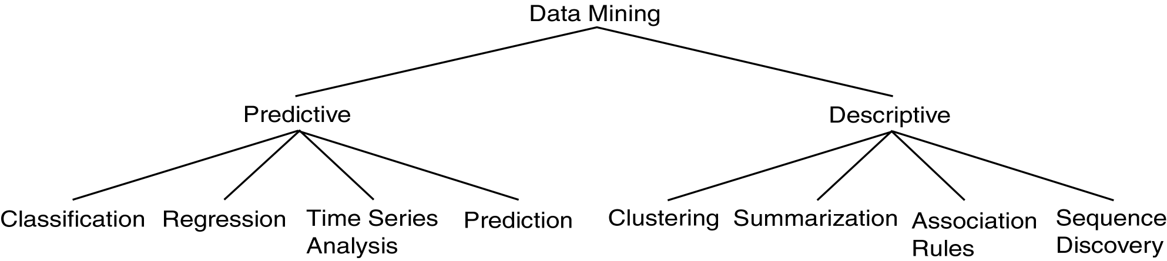
Data Mining Tasks
Dunham, 2003

Slide 27
Data Mining Tasks...
Classification [Predictive]
Clustering [Descriptive]
Association rule discovery [Descriptive]
Regression [Predictive]
Deviation detection [Predictive]

Slide 28
Classification: Definition
Given a collection of records (training set).
Each record contains a set of attributes, one of the attributes is the class.
Find a model for class attribute as a function of the values of other attributes.
Goal: previously unseen records should be assigned a class as accurately as possible.
A test set is used to determine the accuracy of the model. Usually, the given data set is divided into training and test sets, with training set used to build the model and test set used to validate it.

Slide 29
Classification Example
categorical
categorical
continuous
class
Test
Set
Learn
Classifier
Training
Set
Model

Slide 30
Classification: Application 1
Direct Marketing
Goal: Reduce cost of mailing by targeting a set of consumers likely to buy a new cell-phone product.
Approach:
Use the data for a similar product introduced before.
We know which customers decided to buy and which decided otherwise. This {buy, don’t buy} decision forms the class attribute.
Collect various demographic, lifestyle, and company-interaction related information about all such customers.
Type of business, where they stay, how much they earn, etc.
Use this information as input attributes to learn a classifier model.
From [Berry & Linoff] Data Mining Techniques, 1997

Slide 31
Classification: Application 2
Fraud Detection
Goal: Predict fraudulent cases in credit card transactions.
Approach:
Use credit card transactions and the information on its account-holder as attributes.
When does a customer buy, what does he buy, how often he pays on time, etc
Label past transactions as fraud or fair transactions. This forms the class attribute.
Learn a model for the class of the transactions.
Use this model to detect fraud by observing credit card transactions on an account.

Slide 32
Classification: Application 3
Customer Attrition/Churn
Goal: To predict whether a customer is likely to be lost to a competitor.
Approach:
Use detailed record of transactions with each of the past and present customers, to find attributes.
How often the customer calls, where he calls, what time-of-the day he calls most, his financial status, marital status, etc.
Label the customers as loyal or disloyal.
Find a model for loyalty.
From [Berry & Linoff] Data Mining Techniques, 1997

Slide 33
Classification: Application 4
Sky Survey Cataloging
Goal: To predict class (star or galaxy) of sky objects, especially visually faint ones, based on the telescopic survey images (from Palomar Observatory).
3000 images with 23,040 x 23,040 pixels per image.
Approach:
Segment the image.
Measure image attributes (features) - 40 of them per object.
Model the class based on these features.
Success Story: Could find 16 new high red-shift quasars, some of the farthest objects that are difficult to find!
From [Fayyad, et.al.] Advances in Knowledge Discovery and Data Mining, 1996

Slide 34
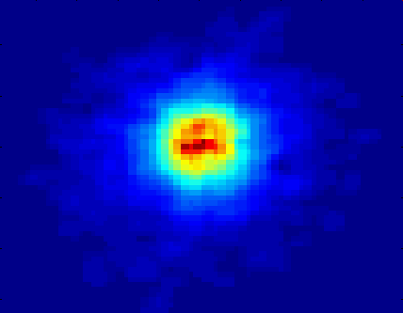
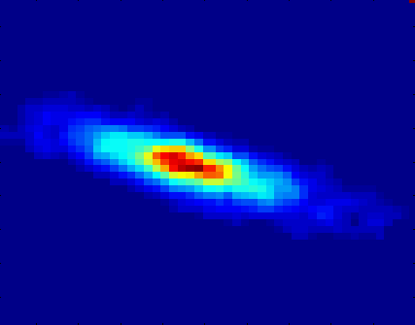
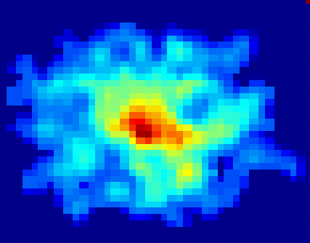
Classifying Galaxies
Courtesy: http://aps.umn.edu
Early
Attributes:
Image features,
Characteristics of light waves received, etc.
Class:
Stages of formation
Intermediate
Late
Data size:
72 million stars, 20 million galaxies
Object catalog: 9 GB
Image database: 150 GB

Slide 35
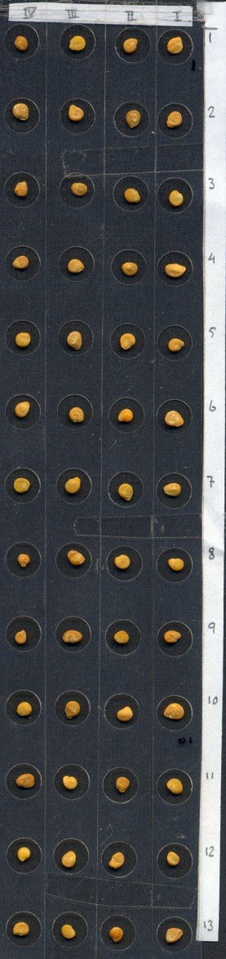
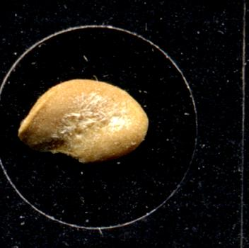


Classification: Application 5
Classification of tomato seeds
Goal: to predict whether tomato seeds germinate
Approach:
“scan” the seeds
extract features
build a classifier
use the classifier to blow away infertile seeds
Notes:
1 kg kwaliteit tomatenzaad kost zo’n 50.000 euro (20 cent per zaadje)

Slide 36
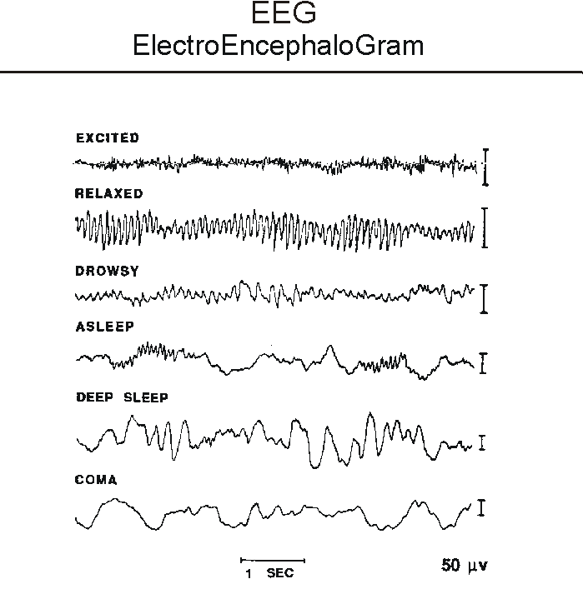
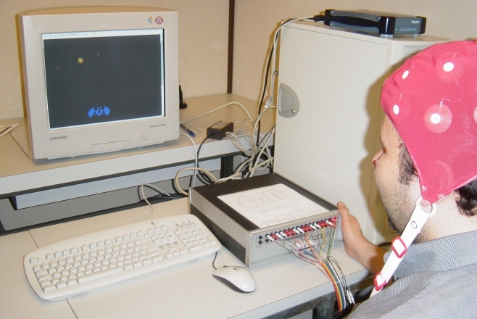
Classification: Example 6
Brain-computer interfacing
Goal: read a person’s mind
Approach:
measure EEG signals
classify them

Slide 37
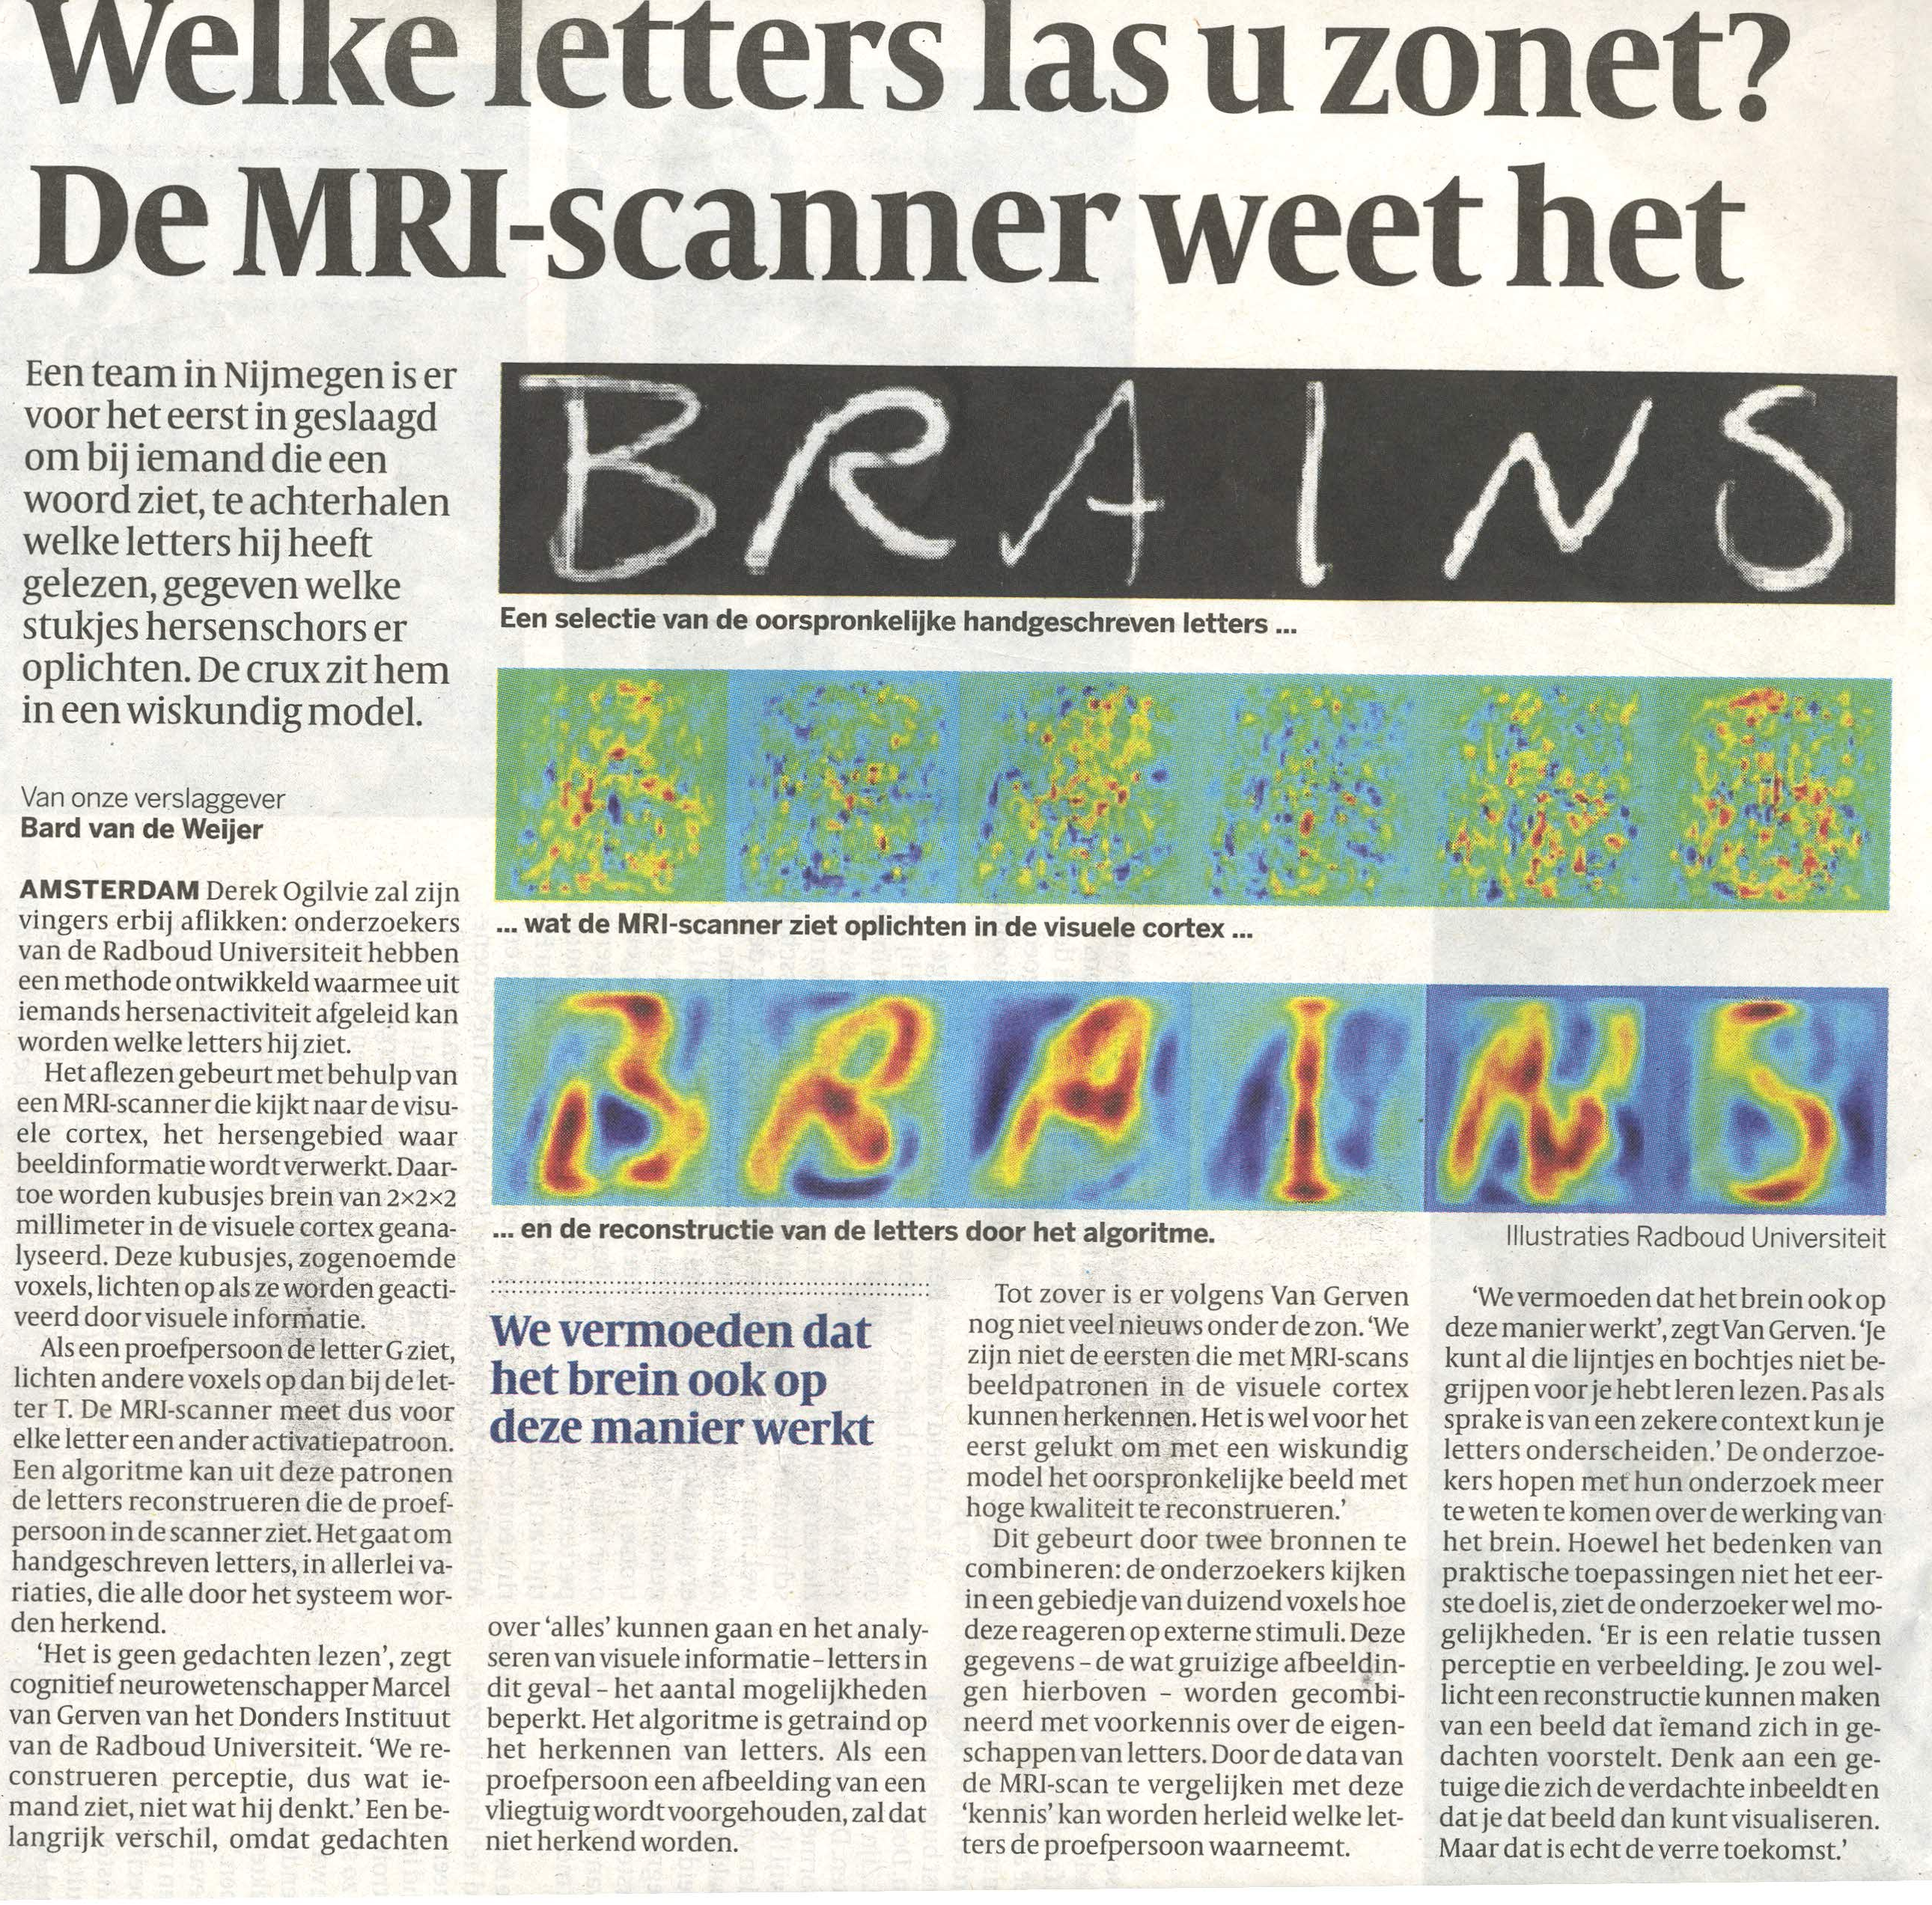
Volkskrant

Slide 38
Clustering Definition
Given a set of data points, each having a set of attributes, and a similarity measure among them, find clusters such that
Data points in one cluster are more similar to one another.
Data points in separate clusters are less similar to one another.
Similarity measures:
Euclidean distance if attributes are continuous.
Other problem-specific measures.

Slide 39
Illustrating Clustering
Euclidean distance based clustering in 3-D space.
Intracluster distances
are minimized
Intercluster distances
are maximized

Slide 40
Clustering: Application 1
Market segmentation
Goal: subdivide a market into distinct subsets of customers where any subset may conceivably be selected as a market target to be reached with a distinct marketing mix.
Approach:
Collect different attributes of customers based on their geographical and lifestyle related information.
Find clusters of similar customers.
Measure the clustering quality by observing buying patterns of customers in same cluster vs. those from different clusters.

Slide 41
Clustering: Application 2
Document clustering
Goal: To find groups of documents that are similar to each other based on the important terms appearing in them.
Approach: To identify frequently occurring terms in each document. Form a similarity measure based on the frequencies of different terms. Use it to cluster.
Gain: Information retrieval can utilize the clusters to relate a new document or search term to clustered documents.

Slide 42
Illustrating Document Clustering
Data points: 3204 articles of Los Angeles Times.
Similarity measure: How many words are common in these documents (after some word filtering).

Slide 43
Clustering of S&P 500 Stock Data
Observe stock movements on a daily basis.
Data points: time series of stock-{up/down}
Similarity measure: Two points are more similar if the events described by them frequently happen together on the same day.

Slide 44
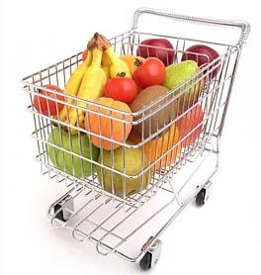
Association Rule Discovery: Definition
Given a set of records each of which contain some number of items from a given collection: Produce dependency rules which will predict occurrence of an item based on occurrences of other items.
Rules Discovered:
{Milk} --> {Coke}
{Diaper, Milk} --> {Beer}

Slide 45
Association Rule Discovery: Application 1
Marketing and sales promotion
Suppose the discovered rule is {Bagels, … } → {Potato Chips}
Potato Chips as consequent: Can be used to determine what should be done to boost its sales.
Bagels in the antecedent: Can be used to see which products would be affected if the store discontinues selling bagels.
Bagels in antecedent and Potato chips in consequent: Can be used to see what products should be sold with Bagels to promote sale of Potato chips!

Slide 46
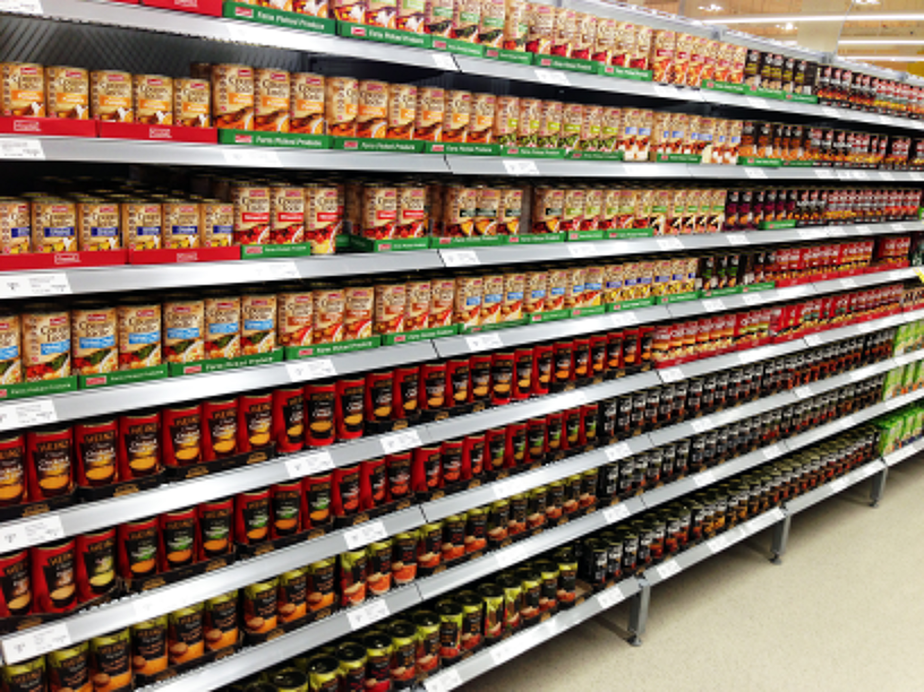
Association Rule Discovery: Application 2
Supermarket shelf management
Goal: To identify items that are bought together by sufficiently many customers.
Approach: Process the point-of-sale data collected with barcode scanners to find dependencies among items.
A classic rule --
If a customer buys diaper and milk, then he is very likely to buy beer (on Thursday)

Slide 47
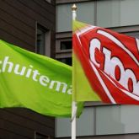
Association Rule Discovery: Application 3
Market basket analysis at Schuitema (now Jumbo)
Goal: find and visualize clusters of products that are “similar”, i.e., are typically bought together with the same products
Approach: self-organizing map using specific similarity measure based on co-occurrence

Slide 48
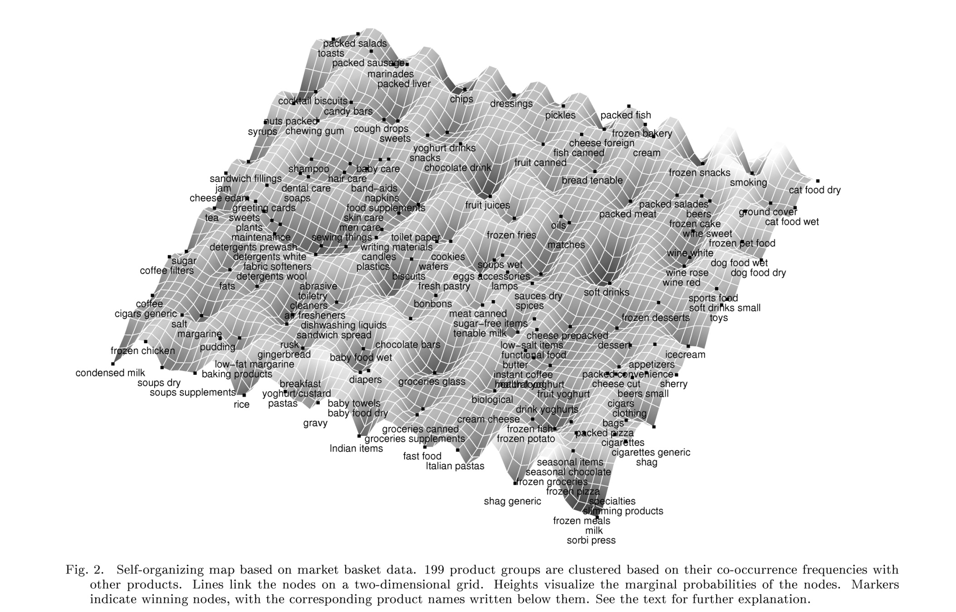
Self-organizing Map

Slide 49
Regression
Predict a value of a given continuous valued variable based on the values of other variables, assuming a linear or nonlinear model of dependency.
Greatly studied in statistics, neural networks.
Examples:
Predicting sales amounts of new product based on advertising expenditure.
Predicting wind velocities as a function of temperature, humidity, air pressure, etc.
Time series prediction of stock market indices.

Slide 50
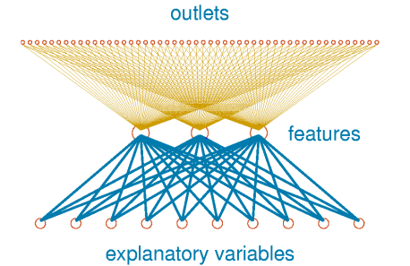
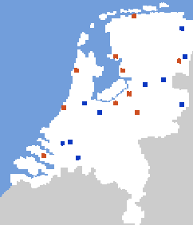
Regression: Application 1
Predicting newspaper sales
Goal: optimize single-copy sales of De Telegraaf
Approach:
learn from past sales
let outlets learn from each other
better weather, more sales
worse weather, more sales

Slide 51



Slide 52
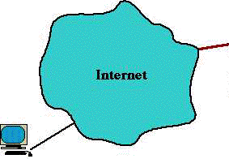
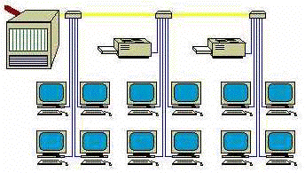
Deviation / Anomaly Detection
Detect significant deviations from normal behavior
Applications:
Credit card fraud detection
Network intrusion detection
Typical network traffic at University level may reach over 100 million connections per day

Slide 53
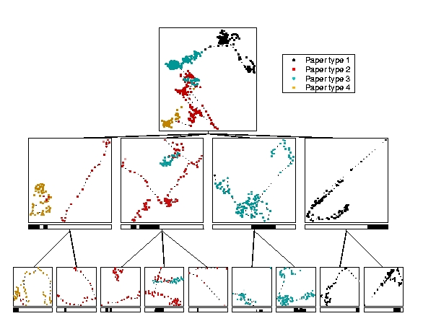
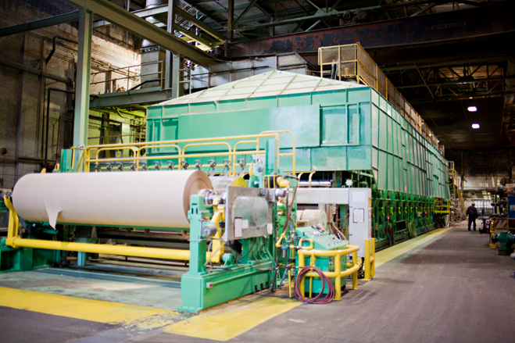
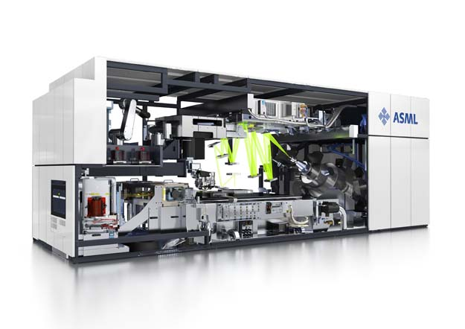
Deviation / Anomaly Detection: Application 1
Monitoring paper mills
Goal: alert operators when the paper mill starts behaving “weirdly”
Approach: visualize the dynamics by cleverly projecting the measurements of hundreds of sensors

Slide 54
Data mining?
Dividing the customers of a company according to their gender.
Predicting the profitability of customers.
Computing the total sales of a company.
Sorting a student database based on student identification numbers.
Predicting the outcomes of tossing a fair pair of dice.
Predicting the outcomes of tossing a possibly unfair pair of dice after having seen some amount of tosses.

Slide 55
Data mining?
Predicting the future stock price of a company using historical records.
Monitoring the heart rate of a patient for abnormalities given observations of both abnormal and normal behavior.
Monitoring the heart rate of a patient for abnormalities given observations of only normal behavior.
Monitoring seismic waves for earthquake activities.
Extracting the frequencies of a sound wave.

Slide 56
Components of Data Mining Algorithms
Representation:
Determining the nature and structure of the representation to be used
Score function:
quantifying and comparing how well different representations fit the data
Search/Optimization method:
Choosing an algorithmic process to optimize the score function
Data Management:
Deciding what principles of data management are required to implement the algorithms efficiently

Slide 57
What’s in a Data Mining Algorithm?
Task
Representation
Score Function
Search/Optimization
Data Management
Models, Parameters
Smyth, 2003

Slide 58
Multivariate Linear Regression
Task
Regression
Representation
Weighted linear sum
Score Function
Least-squares
Search/Optimization
Gaussian elimination
Data Management
None specified
Models, Parameters
Regression coefficients
Smyth, 2003

Slide 59
Decision trees (CART, ID3, …)
Task
Classification
Representation
Axis-parallel decisions
Score Function
Accuracy
Search/Optimization
Greedy search
Data Management
None specified
Models, Parameters
Decision tree classifier
Smyth, 2003

Slide 60
Hierarchical Clustering
Task
Clustering
Representation
Tree of clusters
Score Function
Various
Search/Optimization
Greedy search
Data Management
None specified
Models, Parameters
Dendogram
Smyth, 2003

Slide 61
Association Rules
Task
Pattern Discovery
Representation
IF-THEN rules
Score Function
No explicit score
Search/Optimization
Systematic search
Data Management
Multiple linear scans
Models, Parameters
Set of rules
Smyth, 2003

Slide 62

Data Mining: the Downside
Hype
One of the “weapons of math destruction”
Data dredging, snooping and fishing
Finding spurious structure in data that is not real
Historically, ‘data mining’ was a derogatory term in the statistics community
The Super Bowl fallacy
Bangladesh butter prices and the US stock market
The challenges of being interdisciplinary
computer science, statistics, domain discipline
Notes:
The Super Bowl market indicator holds that stocks will do well after a team from the old National Football League wins the Super Bowl. New England Patriots nailed the Los Angeles Rams (2016); zijn uit de American Football Conference ipv National Football Conference ipv , dus aandelen gaan omlaag!

Slide 63
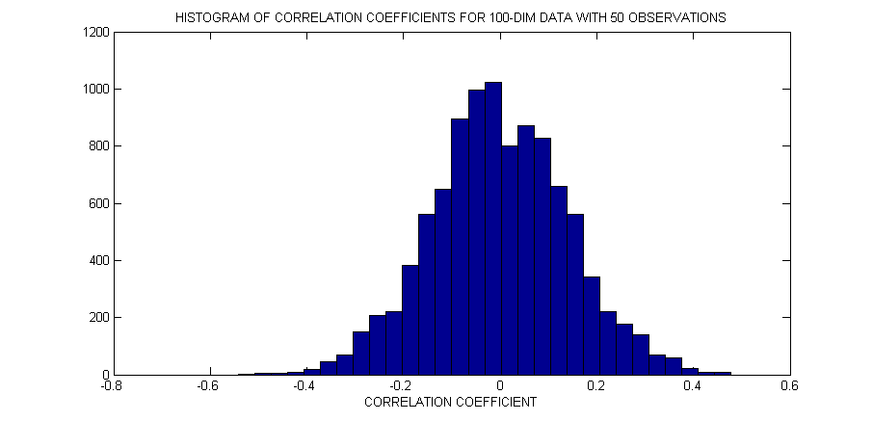
Example of “Data Fishing”
Example: data set with
50 data vectors
100 variables
Even if data are entirely random (no dependence) there is a very high probability some variables will appear dependent just by chance.

Slide 64
PYTHON Code for Correlations
import numpy as np
import matplotlib.pyplot as plt
nObjects = 50
nVariables = 100
# Generate matrix with standard normal random variables
mu = 0.0
sigma = 1.0
x = np.random.normal(mu, sigma, (nVariables, nObjects))
# Compute correlations between variables
corrvector = np.array([])
for i in range(1, nVariables):
for j in range(i+1, nVariables):
# Numpy return the CC’s in matrix format
corMtrx = np.corrcoef(x[:,i], x[:,j])
corrvector = np.append(corrvector, corMtrx[0,1])
# Plot the histogram
plt.hist(corrvector, 20)
plt.show()

Slide 65
PYTHON Code for Correlations
import numpy as np
import matplotlib.pyplot as plt
nObjects = 50
nVariables = 100
# Generate matrix with standard normal random variables
mu = 0.0
sigma = 1.0
x = np.random.normal(mu, sigma, (nVariables, nObjects))
# Compute correlations between variables
correlations = np.corrcoef(x)
dummy = np.triu(correlations, 1);
corrvector = dummy[dummy != 0];
# Plot the histogram
plt.hist(corrvector, 20)
plt.show()

Slide 66
Possible Pitfalls
Let the data speak…
The data may have quite a lot to say….. but it may just be noise!
Smyth, 2003

Slide 67
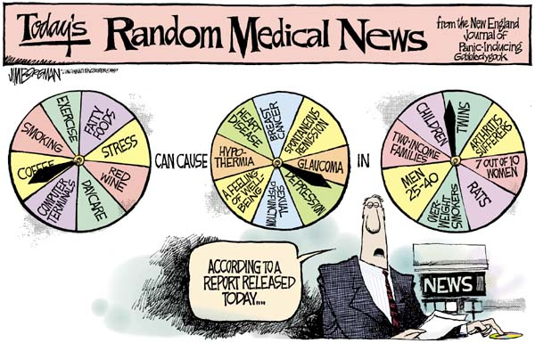
Data Issues in Health Science

Slide 68
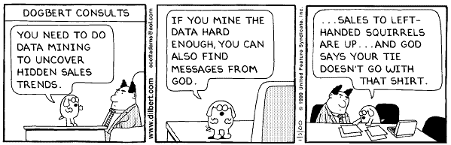
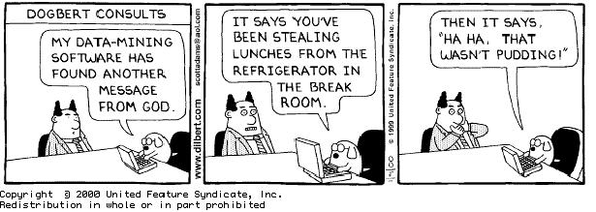
Dilbert (1)

Slide 69
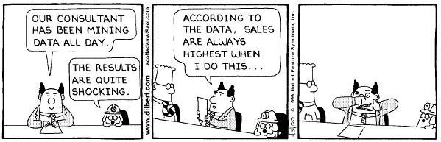
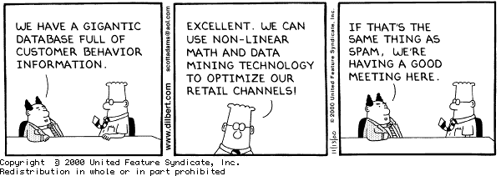
Dilbert (2)

Slide 70
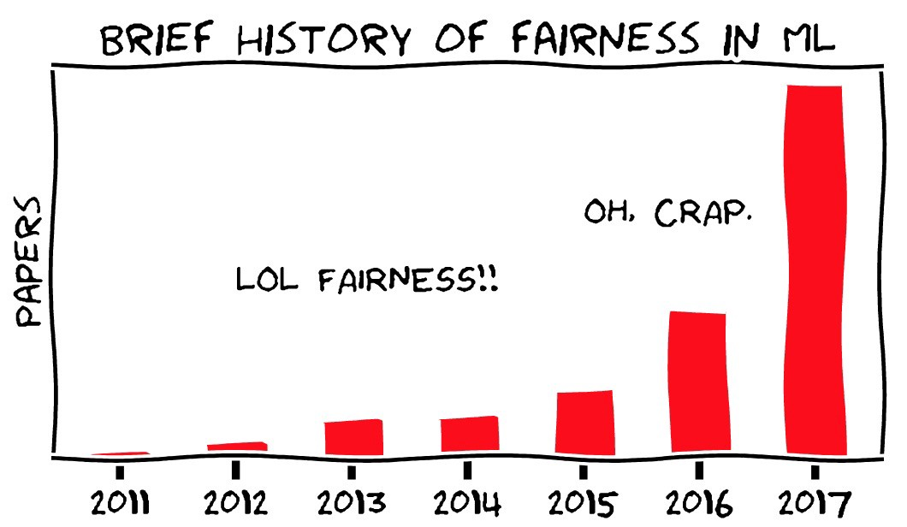
Challenges of Data Mining
Scalability
Dimensionality
Complex and heterogeneous data
Data quality
Data ownership and distribution
Privacy preservation
Fairness
Streaming data (e.g., intrusion detection)

